Slide 1
Visual Analytics and Machine Learning
Mod.100/1

Slide 2
Outline

Introduction
Definition, Machine Learning Pipeline.

Interactive Model Analysis
Fundamentals, Different kinds of Visualization charts and graphs, Visualization Dashboards, Applications.

Visual Analytics for
Understanding, Diagnosing, Refining Models, Learning Visualization.

Integrating Machine Learning into Visual Analytics
Interaction Intent, Semantic Interaction.

Applications Domains and Challenges
Overview of Application domains and challenges.

Slide 3
Visual Analytics and Machine Learning
Machine Learning has been successfully applied to a wide variety of fields:
Information Retrieval;
Data Mining;
Speech Recognition;
Computer Graphics;
Visualization;
Human-Computer Interaction.
Without a clear understanding of how and why a machine learning model works, the development of high-performance models relies on time-consuming and trial-and-error process.

Slide 4
Visual Analytics and Machine Learning
Thus,
there is a need for more transparent and explainable way for better understanding and analysing machine learning models, especially their inner working mechanisms.

Slide 5
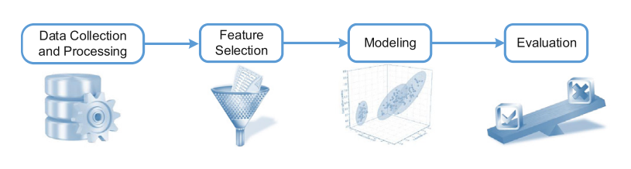
Machine Leaning Pipeline: Typical approach
Visual Analytics and Machine Learning
Source [1]

Slide 6
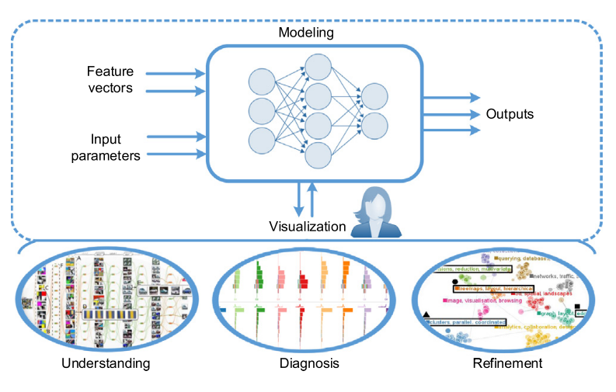
Interactive Model Analysis:
Visual Analytics and Machine Learning
Interactive Visualization plays a critical role in understanding and analysing machine learning models.
Source [1]

Slide 7
Interactive Model Analysis:
Visual Analytics and Machine Learning
Aims to create a suite of visual analytics techniques that:
understand why machine learning models behave the way they do and why they differ from each other (understanding);
diagnose a training process that fails to converge or does not achieve an acceptable performance (diagnosis);
guide experts to improve the performance and robustness of machine learning models (refinement).

Slide 8
Interactive Model Analysis: Understanding Models
Visual Analytics and Machine Learning
Understanding the training process of a model, understanding the parameters of a model, understanding features learned by a model from a given set of data, or understanding the outputs produced by a model.

Slide 9
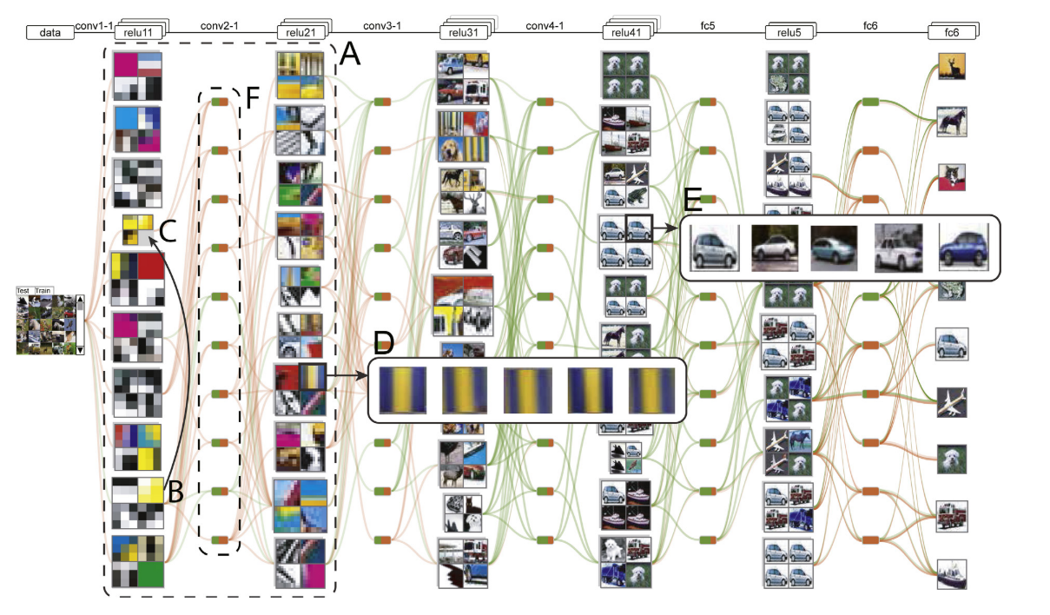
Interactive Model Analysis: Understanding Models
Visual Analytics and Machine Learning
CNNVis: Understanding deep Convolutional Neural Networks (CNNs)
Source [1]

Slide 10
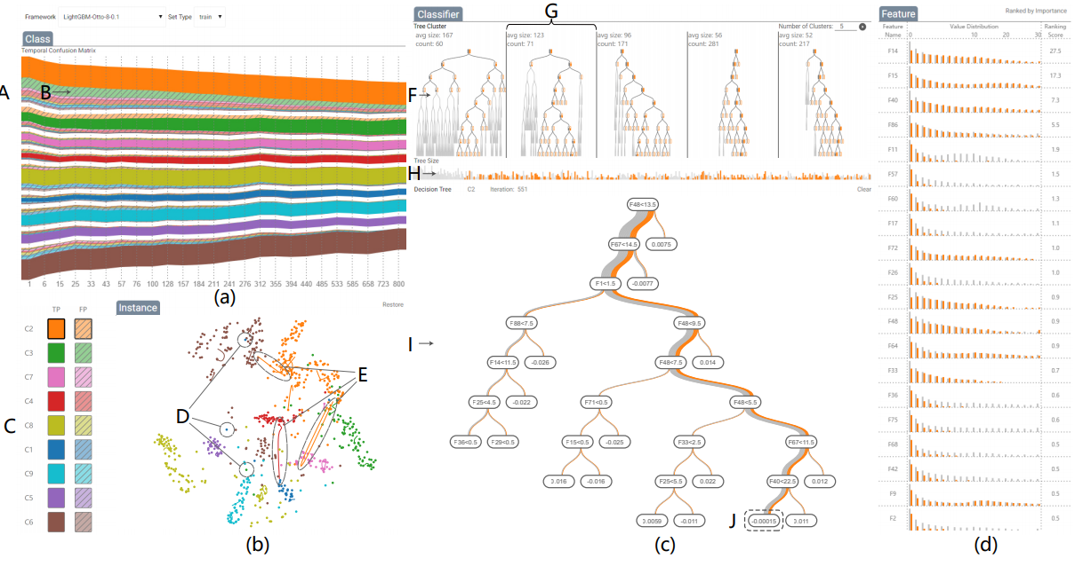
Interactive Model Analysis: Understanding Models
Visual Analytics and Machine Learning
Visual Diagnosis of Tree Boosting Methods
Source [2]

Slide 11
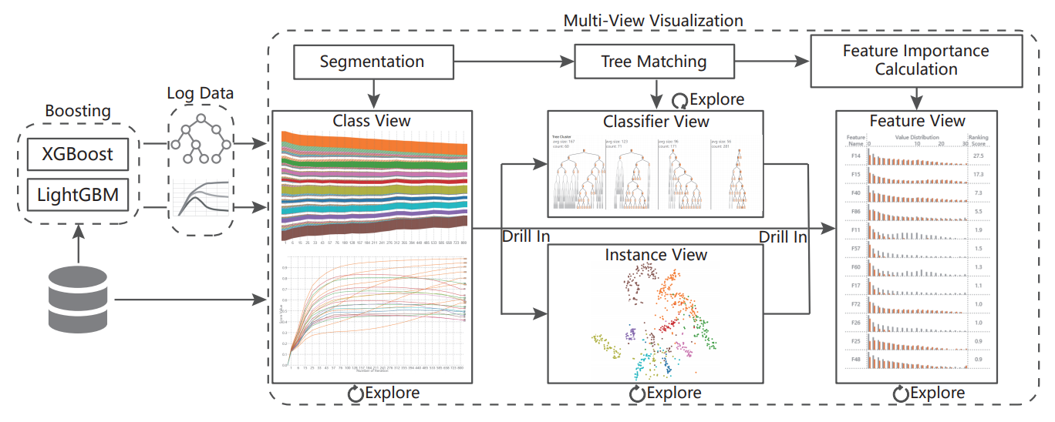
Interactive Model Analysis: Understanding Models
Visual Analytics and Machine Learning
Visual Diagnosis of Tree Boosting Methods – System pipeline
Source [2]

Slide 12
Interactive Model Analysis: Understanding Models
Visual Analytics and Machine Learning
DiTop-View Visualization in which topics are represented by glyphs (topic coins) that are arranged in 2D plane
Topic coins encode all information necessary for performing comparative analysis (class of topic, most probable terms, discriminative relations)

Slide 13
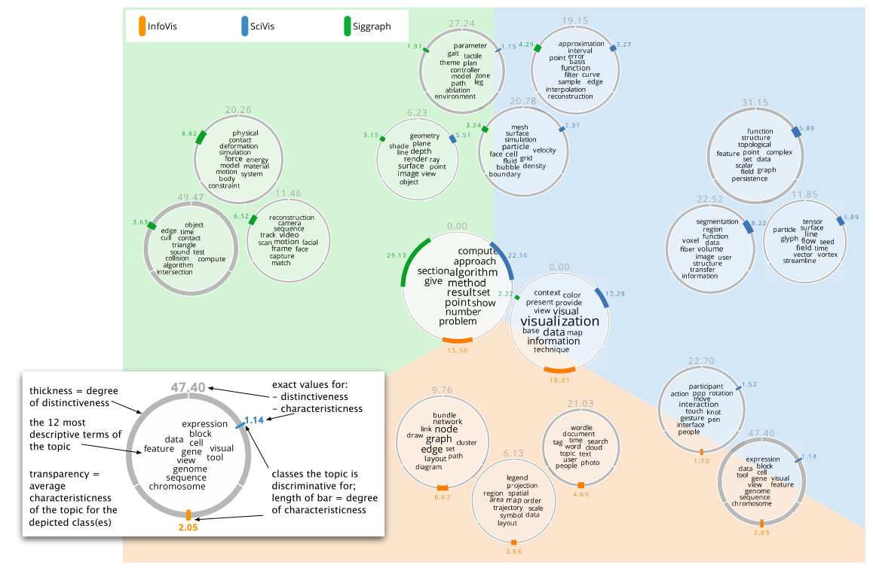
Interactive Model Analysis: Understanding Models
Visual Analytics and Machine Learning
Visual Analytics approach for Visual Exploration of document collections
Comparison of 495 papers of InfoVis, SciVis, and Siggraph
Source [3]

Slide 14
Interactive Model Analysis: Diagnosing Models
Visual Analytics and Machine Learning
Visual Analytics techniques that are used for diagnosing model performance.
The goal of these techniques is to help machine learning experts understand why a training process did not achieve a desirable performance so that they can make better choices (e.g., select better features) to improve the model performance.
Current techniques utilize the prediction score distributions of the model (class probability) to evaluate the error severity and study how the score distributions correlate with misclassification and selected features.

Slide 15
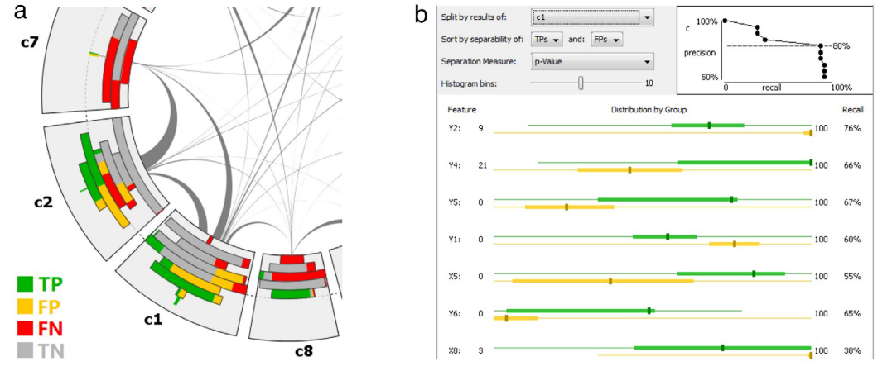
Interactive Model Analysis: Diagnosing Models
Visual Analytics and Machine Learning
A visual analytics tool that helps machine learning experts diagnose model performance with (a) a confusion wheel and (b) a feature analysis view.
Source [1]

Slide 16
Interactive Model Analysis: Refining Models
Visual Analytics and Machine Learning
Visual analytics systems that provide interaction capabilities for improving the performance of models by incorporating the knowledge learned by the experts.
Current techniques focus on multi-class classifiers by controlling factors that significantly affect classification results such as:
training samples,
features,
types of classifiers, and
parameters used in training

Slide 17
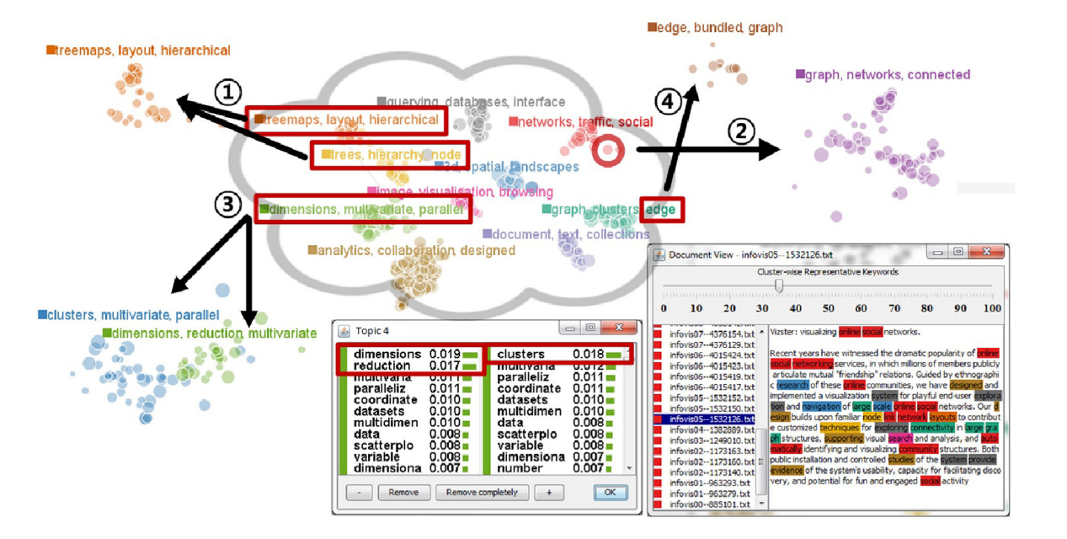
Interactive Model Analysis: Refining Models
Visual Analytics and Machine Learning
UTOPIAN: A Visual analytics system for interactive refinement of topic models
merge topics
create topics based on exemplar documents
split topics
create topics based on keywords
Source [1]

Slide 18
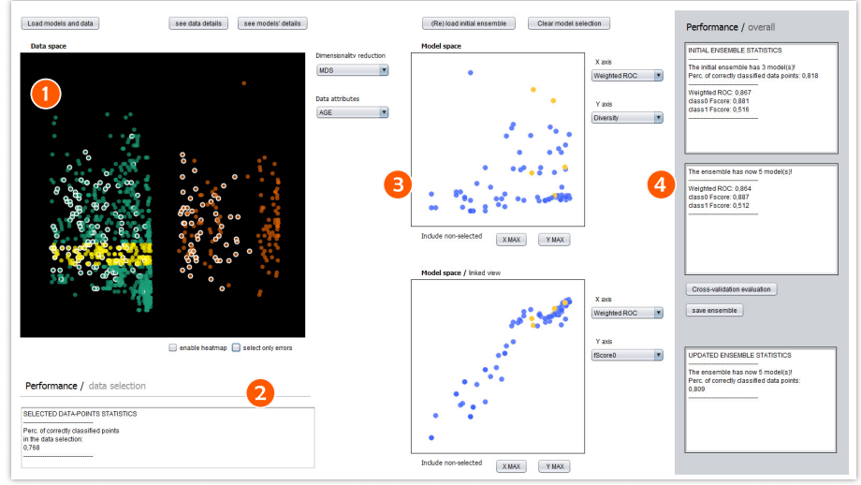
Interactive Model Analysis: Refining Models
Visual Analytics and Machine Learning
Exploring ensembles of classifier
Select regions of the classification outputs
How the ensemble classified these regions
Interact with preloaded collection of models adding or removing them to update the ensemble
track the performance while interacting with the models
Source [4]

Slide 19
Learning Visualization
Visual Analytics and Machine Learning
Machine learning can also be used as a means to improve the visualization process itself.
This can range from methods for recommending visualizations, automating (or semi-automating) the creation of visualizations from a provided dataset, or constructing learning models for visualization techniques.
Automatically identify and interactively recommend visualizations relevant to an analytical task

Slide 20
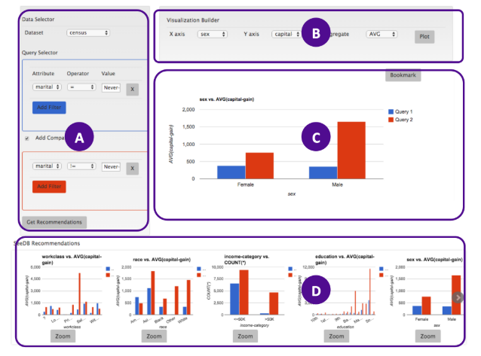
Learning Visualization
Visual Analytics and Machine Learning
SEEDB system
(A) Query builder
(B) Visualization builder
(C) Visualization pane
(D) Recommendation pane
Source [5]

Slide 21
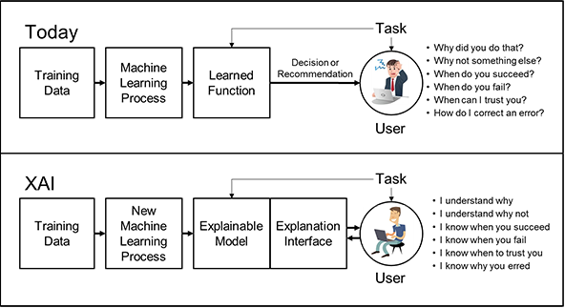
Explainable Artificial Intelligence (XAI)
Visual Analytics and Machine Learning
Released by DARPA I20 program.
DARPA (Defense Advanced Research Projects Agency).
The effectiveness of today’s systems is limited by the machine’s current inability to explain their decisions and actions to human users.
https://www.darpa.mil/program/explainable-artificial-intelligence

Slide 22
Explainable Artificial Intelligence (XAI)
Visual Analytics and Machine Learning
The Explainable AI (XAI) program aims to create a suite of machine learning techniques that:
Produce more explainable models, while maintaining a high level of learning performance (prediction accuracy);
Enable human users to understand, appropriately trust, and effectively manage the emerging generation of artificially intelligent partners.

Slide 23
Integrating Machine Learning into Visual Analytics
Visual Analytics and Machine Learning
Two perspectives
Type of ML algorithms
Algorithms that tackle tasks like:
Dimension reduction, classification, clustering, regression analysis
Interaction intent
Modify parameters and computation domain
Define analytical expectations

Slide 24
Integrating Machine Learning into Visual Analytics
Visual Analytics and Machine Learning
Interaction Intent
Modify parameters and computation domain
Modify Parameters of an algorithm or defining the measures used.
Modify Computational Domain to which the algorithm is applied.
Select subsets of the data and run the algorithms on these selections within the visual analysis cycle to observe the changes in the results and refine the model iteratively.

Slide 25
Integrating Machine Learning into Visual Analytics
Visual Analytics and Machine Learning
Interaction Intent
Define analytical expectations
Users communicate expected results to the computational method.
User often observe the output of an algorithm and tell the machine which aspect of the output is inconsistent with the existing knowledge ( correcting the algorithm).
E.g. Scattergather technique to iteratively break up or merge clusters to generate groupings that meet the analysts expectation.

Slide 26
Integrating Machine Learning into Visual Analytics
Visual Analytics and Machine Learning
Semantics Interaction
An approach to user interaction for visual data exploration in which analytical reasoning of the user is inferred and in turn used to steer the underlying models implicitly.
Coupling cognitive and computation without requiring the user to directly control the models.
https://gtvalab.github.io/

Slide 27
Application Domains
Visual Analytics and Machine Learning
Various different domains for integrating ML and Visual Analytics
Text analytics and topic modelling;
Multimedia visual analytics;
Streaming data: Finance, cyber security, social media;
Biological data.

Slide 28
Challenges
Visual Analytics and Machine Learning
Creating and training models from user interaction data;
Balancing human and machine effort, responsibility and tasks;
Complex computation systems can lead to automation surprise;
Visualizing intermediate results and computational process;
Enhancing trust and interpretability.

Slide 29
References
Visual Analytics and Machine Learning
Papers
S. Liu, X. Wang, M. Liu, and J. Zhu, “Towards better analysis of machine learning models: A visual analytics perspective,” Vis. Informatics, vol. 1, no. 1, pp. 48–56, 2017.
S. Liu, J. Xiao, J. Liu, X. Wang, J. Wu, and J. Zhu, “Visual Diagnosis of Tree Boosting Methods,” IEEE Trans. Vis. Comput. Graph., vol. 24, no. 1, pp. 163–173, 2018.
D. Oelke, H. Strobelt, C. Rohrdantz, I. Gurevych, and O. Deussen, “Comparative exploration of document collections: A visual analytics approach,” Comput. Graph. Forum, vol. 33, no. 3, pp. 201–210, 2014.
B. Schneider, D. Jackle, F. Stoffel, A. Diehl, J. Fuchs, and D. Keim, “Visual integration of data and model space in ensemble learning,” 2017 IEEE Vis. Data Sci. VDS 2017, pp. 15–22, 2018.
M. Vartak, S. Huang, T. Siddiqui, S. Madden, and A. Parameswaran, “Towards visualization recommendation systems,” SIGMOD Rec., vol. 45, no. 4, pp. 34–39, 2016.
H. Kim, J. Choo, H. Park, and A. Endert, “InterAxis : Steering Scatterplot Axes via Observation-Level Interaction,” IEEE Trans. Vis. Comput. Graph., vol. 22, no. 1, pp. 131–140, 2016.

Slide 30

Get In Touch
+351 253 510 580
www.ccg.pt
CCG-Centro-de-Computação-Gráfica
info@ccg.pt
Campus de Azurém
Centro de Computação Gráfica
4800-048 Guimarães
Portugal

Slide 31
Thanks

